Slide 1

REFACTORING legacy code
step-by-step

Slide 2

This is not a work of fiction.
Design Flaws and Bugs are neither the product of the author's imagination nor used fictitiously.
Any resemblance to real legacy projects is entirely non coincidental.

Slide 3


Slide 4


Slide 5


Slide 6


Slide 7
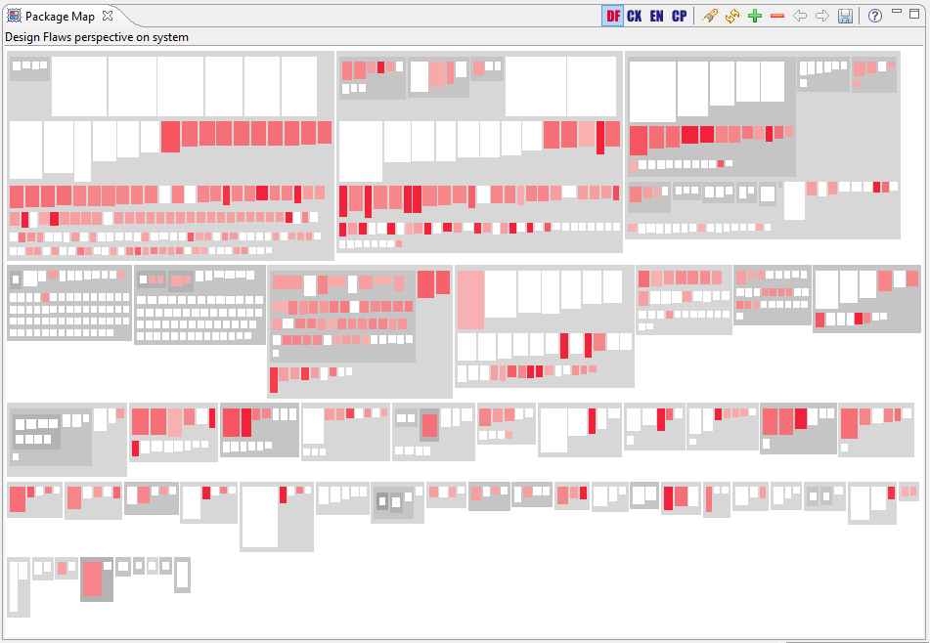

Slide 8

MEETINGS

Slide 9
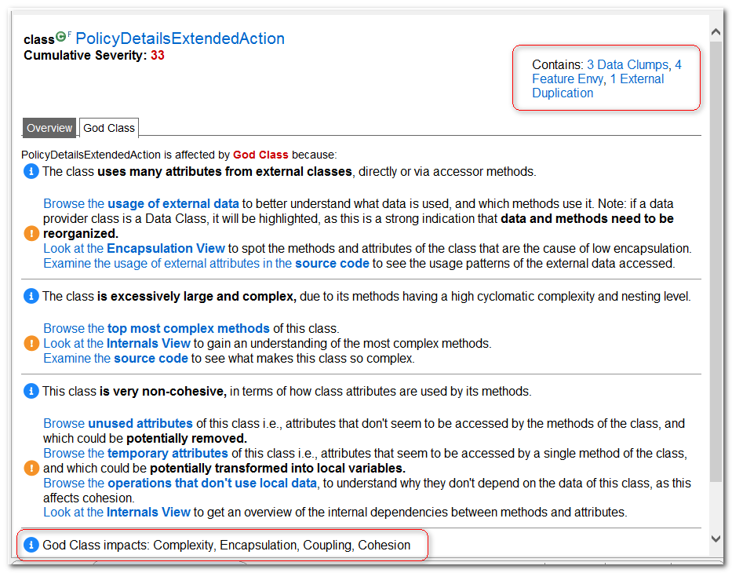
Uses many attributes from external classes
Is excessively large and complex
Is very non-cohesive

Slide 10
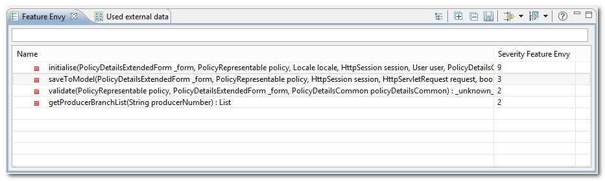
Feature Envy
Data and behavior that acts on that data belong together. When a method makes too many calls to other classes to obtain data or functionality, Feature Envy is in the air.
4 methods are affected by this design flaw

Slide 11
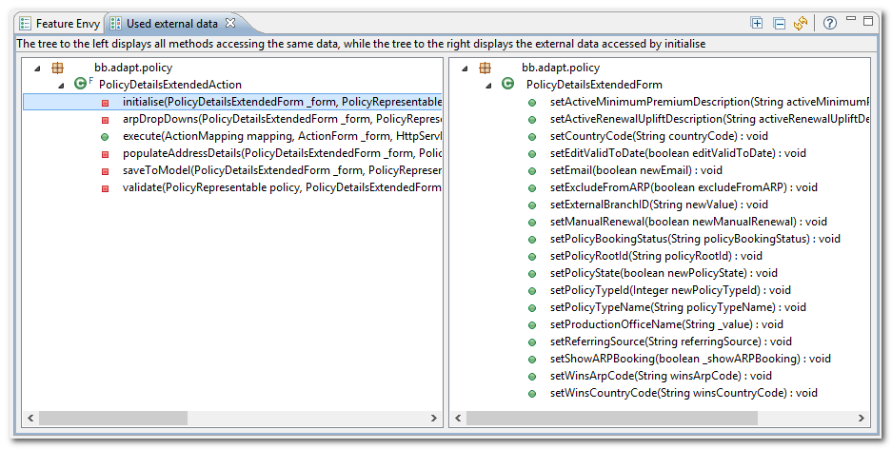
Feature Envy
All methods are envy on Policy Details Extended form datas

Slide 12
Feature Envy
This is a Context Object and its role is to encapsulate state in a protocol independent way.
This Design Flaw doesn't harm the application and can be ignored
POST /path/policy.do HTTP/1.0
User-Agent: HTTPTool/1.0
Content-Type: application/x-www-form-urlencoded
Content-Length: 532
policyType=1&eCommerceSys=153

Slide 13
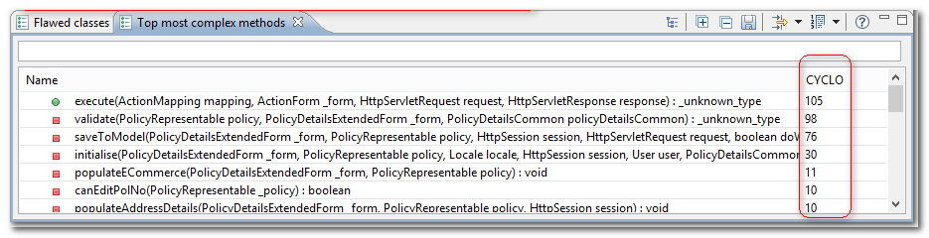
Complexity
This is the MAJOR design flow found in this class. The Long Methods with very high cyclomatic complexity make the code hard to understand, maintain and test.
105 + 98 + 76 + 30 + 11 + 10 + 10 + … = 350 ~ 400

Slide 14

non-cohesive

Slide 15
responsibilities
1. Orchestrates Business Services (3)
2
3
4
POST /path/policy.do HTTP/1.0
User-Agent: HTTPTool/1.0
policyType=1&transType=newPolicy
6
1
7
5
1. Populate action form based on request parameters
5. Compute data based on business logic and populate the presentation model
2. Invoke the action mapped to process the incoming request
6. Identify the view responsible to render the response
3. Orchestrate a set of Business service
7. Delegate the rendering logic to a set of view helpers to avoid logic duplication
4. Manage the Domain Model

Slide 16


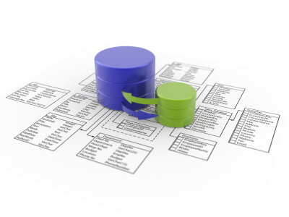
responsibilities
Initialize
Hide / show fields
Validate
policy type specific business rules are applied (use third party service to validate address)
Save
Populates the Domain Model using the values provided by Presentation Model
Pre populate combo box

Slide 17
Cyclomatic complexity / commits

Slide 18

maintainability cost

Slide 19
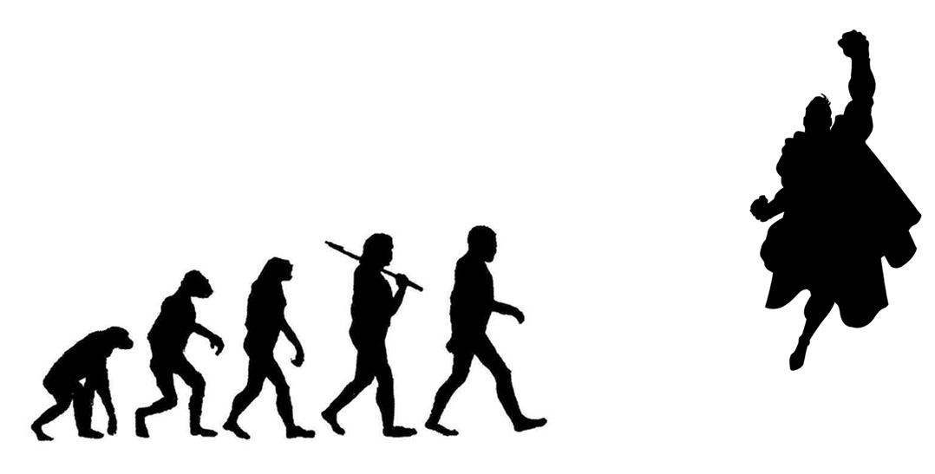
What is Refactoring?
Refactoring is the process of changing a software system in such a way that it does not alter the external behavior of the code yet improves its internal structure.

Slide 20

How You Refactor?
4 Rules to keep in mind when refactoring code:
It passes ALL the tests (preserve its external behavior)
It minimizes duplication in all its forms
It expresses its intent clearly to the reader
It removes unnecessary element

Slide 21
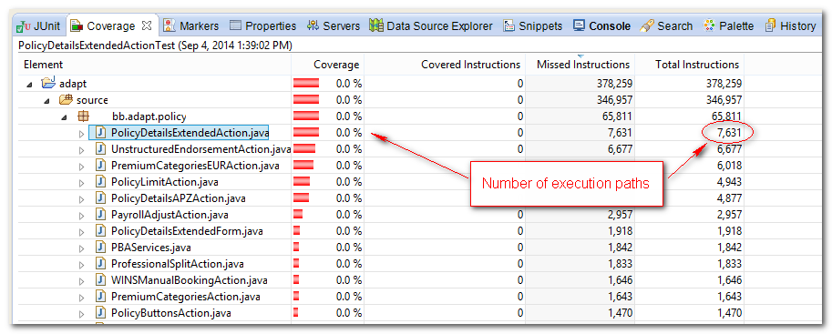
Rule number one
It passes ALL the tests (preserve its external behavior)
0,0%
7.631
Number of execution paths
One unit test case in 3 minutes
One man day (6 hours) = 120 branches covered per day
7631 / 120 ~ 64 days
5 day per week = 13 weeks
TOTAL: 3+ months

Slide 22



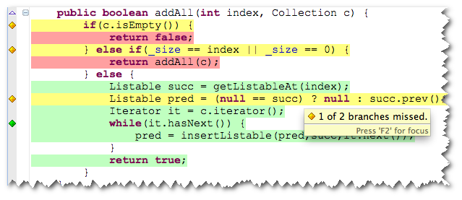
Golden Master technique
It allows for quick production of reliable non regression tests to facilitate code refactoring.

Slide 23
Input data
Generate enough pseudo-random data
Use a code coverage data

Slide 24
1
if (PolicyTypes.isUKPolicyType(policy.getPolicyTypeId().intValue())
|| _form.getStatus() == Status.RENEWING) {
if (_form.getWinsArpCode().equals("Y")) {
policy.setBookedStatus(BookingStatus.ELIGIBLE_FOR_AUTOBOOKING_HELD);
} else if (_form.getWinsArpCode().equals("C")) {
policy.setBookedStatus(BookingStatus.FORCED_INVITE);
} else if (_form.getWinsArpCode().equals("E")) {
policy.setBookedStatus(BookingStatus.ELIGIBLE_FOR_AUTOBOOKING);
}
}
2
3
1
{UK/Travel=1, IT/Travel=7}
2
{RENEWING=W,NEW=N}
3
{Y,C,E}

Slide 25
1
1 | 7
2
W | W | N | N
3
Y | Y | Y | Y | C | C | C | C | E | E | E | E
1 | 7 | 1 | 7 | 1 | 7 | 1 | 7 | 1 | 7 | 1 | 7
W | W | N | N | W | W | N | N | W | W | N | N
Y | Y | Y | Y | C | C | C | C | E | E | E | E
12

Slide 26
Identify the right Output
Find a way to capture the output of the system without changing the production code
Direct output
Computed ActionForward
Indirect output
HttpSession (Domain Model)
Presentation Model
HttpRequest
Thrown Exceptions
Unexpected output
Errors sent by email to operation team

Slide 27

PERSIST THE Output
Use a non intrusive solution - the existing code should not be modified
Non Serializable objects must be serialized too
Persist the output into a human readable format
Provide a mechanism to omit some fields
Current date/time populated somewhere by one of the SUT indirect colaborators
Error stack
framework: XStream
serializer.registerOmitField(Policy.class, “creationDate");
serializer.registerOmitField(Policy.class, "lastModifiedDate");
serializer.registerOmitField(Throwable.class, "stackTrace");

Slide 28
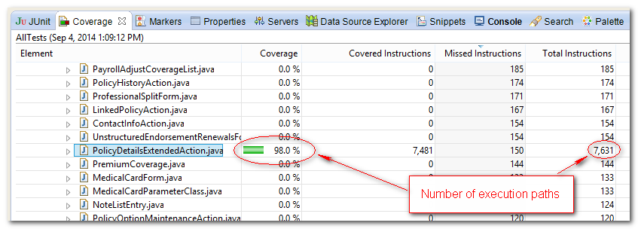
Final results
98,0%
Number of execution paths

Slide 29
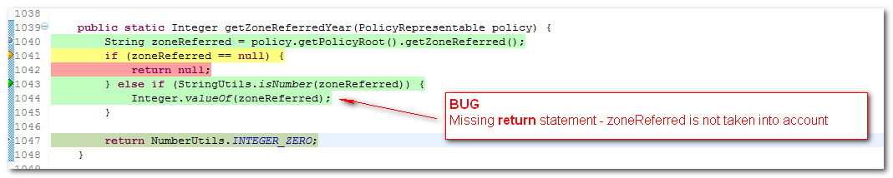
BUG
Missing return statement
zoneReferred value is computed but not used – always returns 0 b.c.

Slide 30
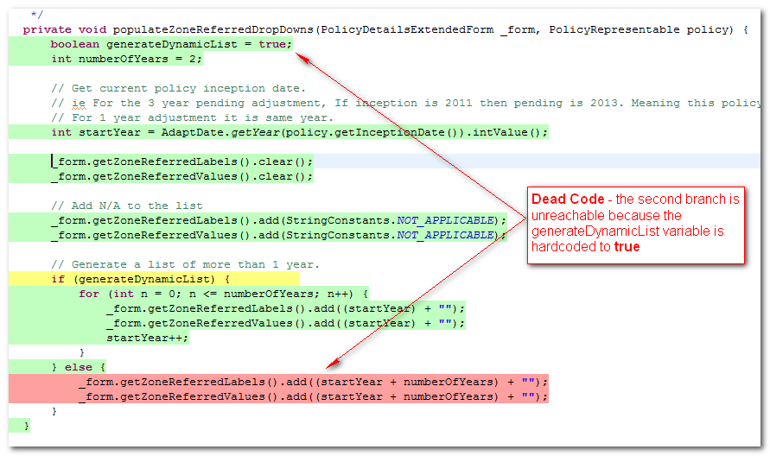
Dead code
Dead Code
the second branch is unreachable because the generateDynamicList variable is hardcoded to true

Slide 31
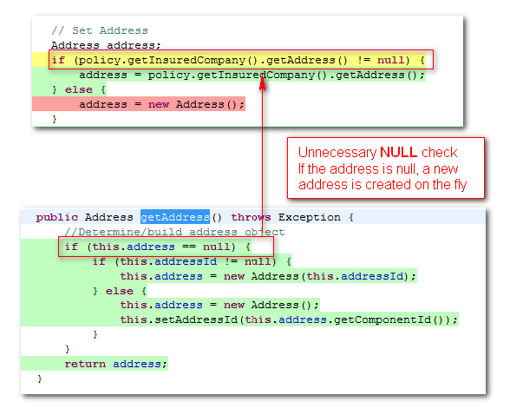
Defensive Programming
Unnecessary null check
if the address is null, a new address is created on the fly.

Slide 32
Let’s refacTor
Policy Type is used to implement business rules variations for all 3 responsibilities:
initialize
validate
save
32
Accident / Travel
ITA
2010
if (PolicyTypes.isUKPolicyType(policy.getPolicyTypeId().intValue())

Slide 33

Code fragility
Common to ALL
COUNTRY specific
YEAR / TYPE specific
Method body
Method body
> 1k

Slide 34
Proposed refactoring approach
ALL
IT
2010/Travel
2012/Travel
UK
2010/Accident
Common to ALL Policies
Common to a specific COUNTRY
Specific by YEAR / TYPE
RESPONSIBILITIES
I N I T I AL I ZE
VAL I DATE
SAVE

Slide 35

values
Improve maintainability
Principles
Single Responsibility Principle
Open for Extension Close for Modification
Group together things that change together

Slide 37

revert
green
red
commit
refactor
green

Slide 38
Extract ALL initialization rules into a new Class
The refactoring steps are depicted below
Use Extract Class and create a new class to express the split-off responsibilities
Use Move Field on each relevant field
Use Move Method to move method over from old class to new one
Use Replace constructor with Factory Method and create a new dedicated class responsible to provide the right subclass of InitializePolicyFormService based on Policy Type. In this way we separate the instantiation responsibility from initialization responsibility.

Slide 39
Extract NDL specific initialization rules into a new Subclass that extends the Class created above
The refactoring steps are depicted below
Use Extract Subclass and define a new subclass that hosts the specific NDL initialization rules
Use Push Down Method on methods specific to NDL.
Copy methods that contains conditional logic specific to NDL and simplify the method preserving only the conditional leg relevant for NDL context. Make the original method protected
Update the Factory Class to return this subclass if Policy Type belongs to NDL

Slide 40
Refactor the Factory Method
Use Replace conditional dispatcher with Command
Repeat steps (B) and (C) for each Country / Year / Policy Type.

Slide 41

Why Should You Refactor?
Refactoring Improves the Design of Software
Without refactoring, the design of the program will decay (people change code to realize short-term goals without a full comprehension of the design)
Loss of the structure of code has a cumulative effect (the harder it is to see the design in the code, the harder it is to preserve it)
Notes:
Emergent design – create an initial design and then extend the design as we learn more

Slide 42

Notes:
Emergent design – create an initial design and then extend the design as we learn more

Slide 43

Thank you
Notes:
Emergent design – create an initial design and then extend the design as we learn more

Slide 44
Books
http://www.amazon.com/Refactoring-Improving-Design-Existing-Code/dp/0201485672
http://www.amazon.com/Refactoring-Patterns-Joshua-Kerievsky/dp/0321213351
Articles
http://java.dzone.com/articles/testing-legacy-code-golden
http://blog.adrianbolboaca.ro/2014/05/legacy-coderetreat-golden-master/
http://martinsson-johan.blogspot.fr/2014/01/golden-master-and-legacy-few-insights.html
Tools
http://approvaltests.sourceforge.net/
http://xstream.codehaus.org/
https://www.intooitus.com/products/incode

